Slide 1
TEAM Arduina
Team Members
Manan Bindra
Harshit Mathur
Ayushi Goyal
Dheeraj Suthar

Slide 2
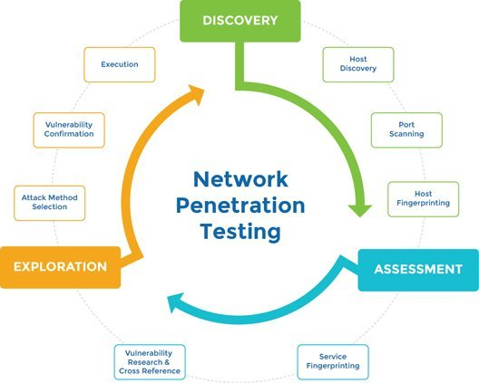
Penetration Testing and Information Gathering

Slide 3
Numbers……….
Total Attacks
434

Slide 4
Types of Attack
Android
Malware
SQL Injection
XSS
DDOS
Network
Packet Sniffing
ARP Poisoning

Slide 5
Types of Data Collected
Employ details
Aadhar Card number
E-mail ID
Password
Company Database
Root user access
Country Targeted
India , Pakistan , UK, USA, Nepal , Bangladesh, South Africa, Euganda

Slide 6
Types of Data Collected
Employ details
Aadhar Card number
E-mail ID
Password
Company Database
Root user access

Slide 7
SQL Injection
SQL injection is a code injection technique, used to attack data-driven applications, in which nefarious SQL statements are inserted into an entry field for execution .
There are two methods approach to prevent sql injection-
SANITIZATION- Sanitization usually involves running any submitted data through a function to ensure that any dangerous characters (like " ' ") are not passed to a SQL query in data.
VALIDATION- It is the basic level this includes ensuring that e-mail addresses contain an "@" sign, that only digits are supplied when integer data is expected, and that the length of a piece of data submitted is not longer than the maximum expected length.

Slide 8
XSS
Cross-site scripting (XSS) is a type of computer security vulnerability typically found in web applications. XSS enables attackers to inject client-side scripts into web pages viewed by other users. A cross-site scripting vulnerability may be used by attackers to bypass access controls such as the same-origin policy.
Ways to Keep Cross-Site Scripting Out of Your Apps
EscapingThe first method you can and should use to prevent XSS vulnerabilities from appearing in your applications is by escaping user input. Escaping data means taking the data an application has received and ensuring it’s secure before rendering it for the end user.
Validating InputValidating input is the process of ensuring an application is rendering the correct data and preventing malicious data from doing harm to the site, database, and users.

Slide 9
DDOS
Distributed DoS attack. A distributed denial-of-service (DDoS) attack occurs when multiple systems flood the bandwidth or resources of a targeted system, usually one or more web servers. Such an attack is often the result of multiple compromised systems (for example, a botnet) flooding the targeted system with traffic.
How to stop a DDoS attack
1. Identify the DDoS attack early
If you run your own servers, then you need to be able to identify when you are under attack. That's because the sooner you can establish that problems with your website are due to a DDoS attack, the sooner you can stop the DDoS attack.
2. Overprovision bandwidth
It generally makes sense to have more bandwidth available to your Web server than you ever think you are likely to need. That way, you can accommodate sudden and unexpected surges in traffic that could be a result of an advertising campaign, a special offer or even a mention of your company in the media.

Slide 10
Network Sniffing
A network sniffer (also known as a network analyzer, protocol analyzer or packet analyzer) is a software or hardware tool that can intercept and log traffic on a digital network. As data flows across the network, the sniffer captures each packet and, if necessary, decode the packet's raw data.
How to prevent a sniffer
Encrypt everything you send or receive
Scan your networks for any issues or dangers
Use only trusted Wi-Fi networks

Slide 11
Link for Reference
https://drive.google.com/drive/u/0/folders/1IIQ-Bi-ZBnKIHwtr5jfu86HWF7d3HqX8
Thank you

